Slide 1
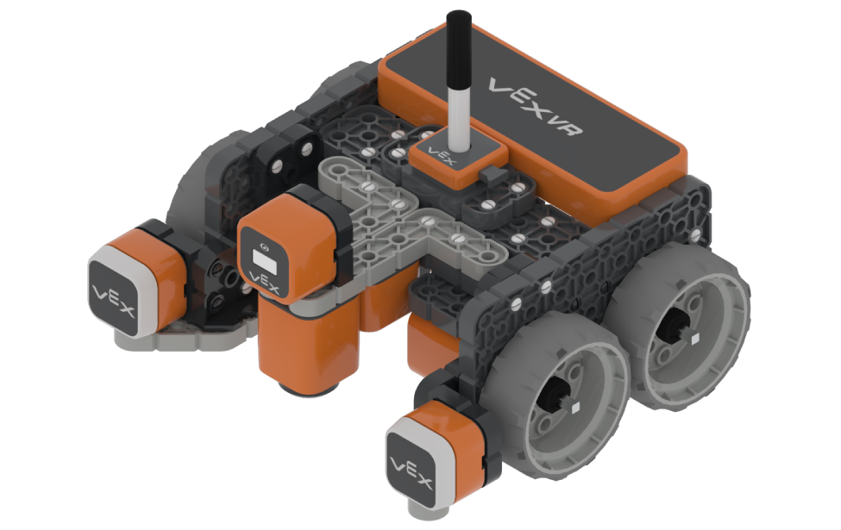
HIDDEN PIXEL ART
http://vr.vex.com

Slide 2
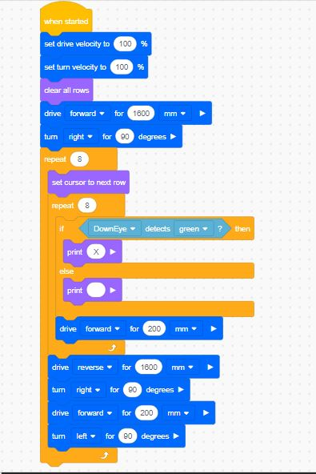
Code Hidden Pixel Art

Slide 3
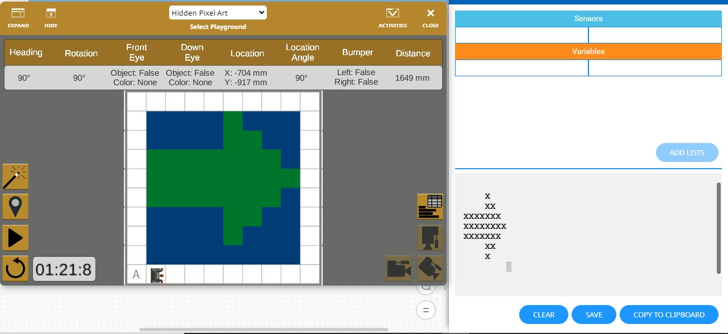
Playground

